Slide 1


A Cloud-Native Serverless Architecture Deployed on AWS
Cloud Computing Technologies - Final Project
Calloni Matteo - 77021A

Slide 2
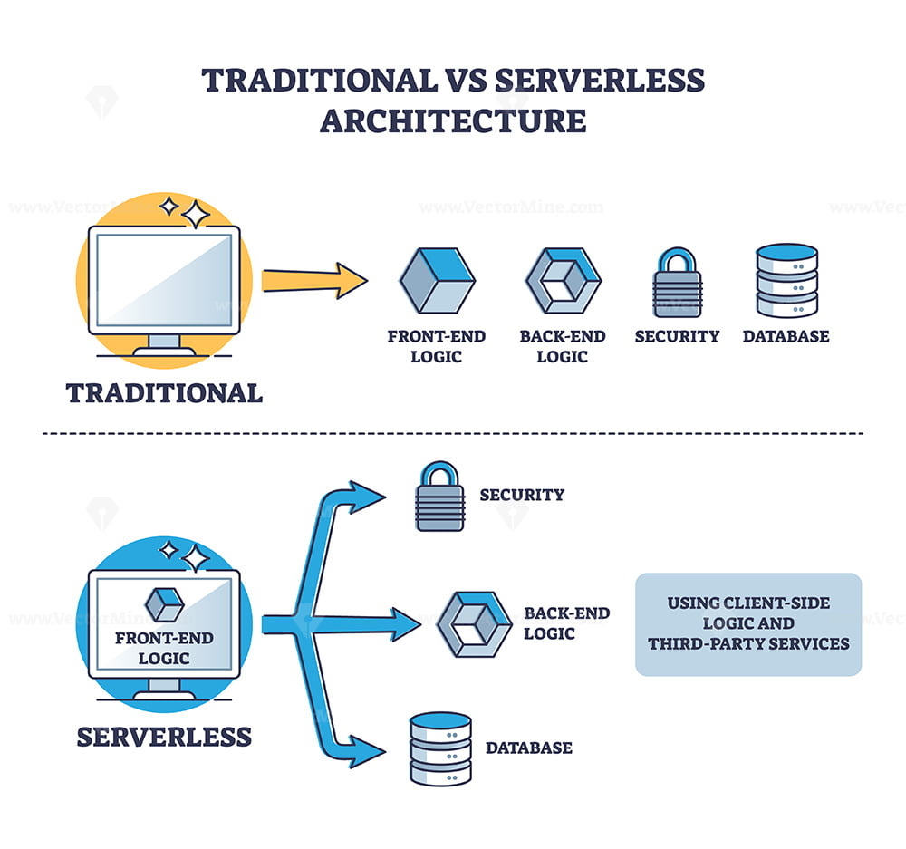
Objectives & Motivations
Shift from IaaS to FaaS: Eliminating server provisioning and management (NoOps approach).
Cloudonomics: Validating the pay-per-use financial model (zero cost during idle times).
Rapid Elasticity: Testing automatic horizontal scaling under sudden traffic spikes.

Slide 3

Event-Driven Pipeline
Ingestion: Amazon S3 acts as a Data Lake, generating trigger events upon file upload.
Compute: AWS Lambda provides stateless, asynchronous processing.
Persistence: Amazon DynamoDB stores structured metadata permanently.

Slide 4
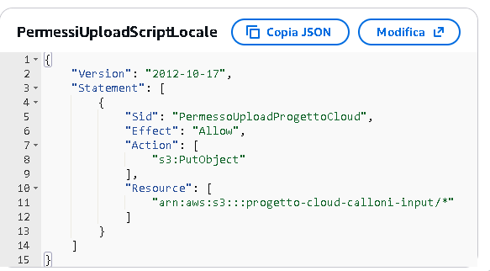
Security & Least Privilege Principle
No use of root credentials for the application layer.
Lambda Execution Role: Strict permissions limited to S3 (Read) and DynamoDB (Write).
Client Inline Policy: Exclusive s3:PutObject authorization restricted to the target bucket.

Slide 5
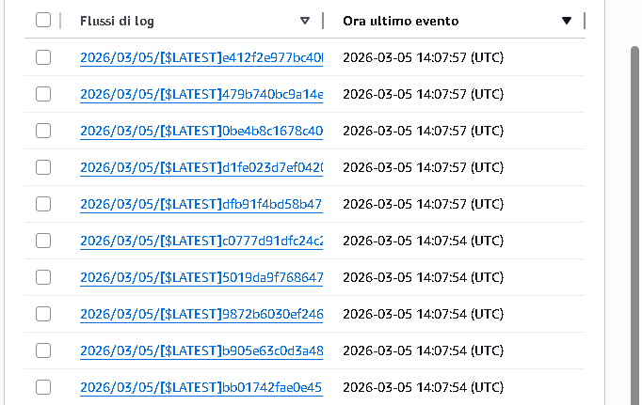
Performance Monitoring
Deep integration with Amazon CloudWatch.
Separate Log Streams for each instantiated container.
Real-time metrics tracking: Total Invocations vs Concurrent Executions.

Slide 6
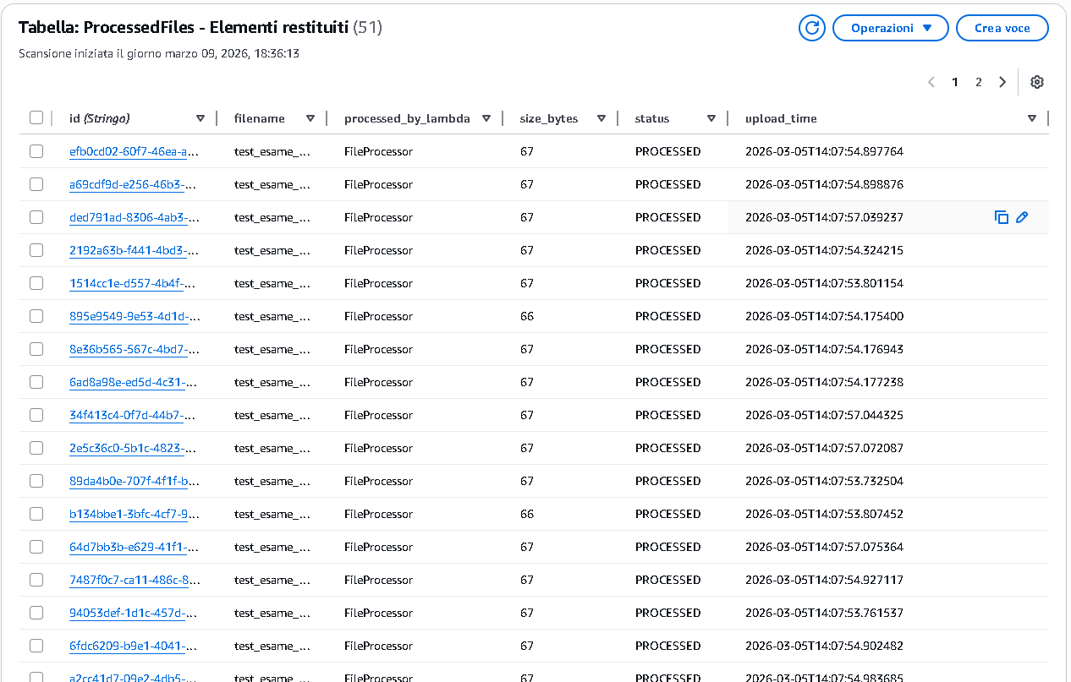
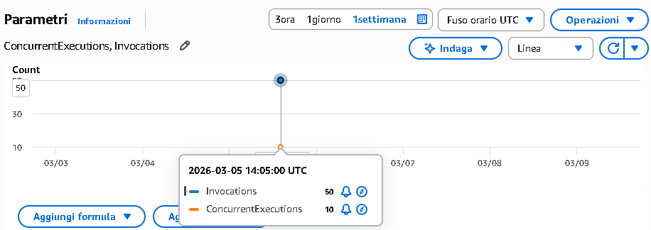
Massive Load Simulation (Live Demo)
Initial State: System at rest (Zero active servers).
Action: Concurrent upload of 50 files via local script (ThreadPoolExecutor).
Result: Instant scaling and database population.

Slide 7
Conclusions
Total Decoupling: Storage, Compute, and Database scale completely independently.
Financial Optimization: Expenses strictly limited to the actual milliseconds of execution (validating Cloudonomics).
Time-to-Market: Focus shifted entirely to business logic, delegating High Availability (HA) to the Cloud Provider.

